Slide 1
Problem Statement
Our goal is to predict whether a meme is hateful or non-hateful. This is a binary classification problem with multimodal input data consisting of the meme image itself (the image mode) and a string representing the text in the meme image (the text mode).

Slide 2
Task 1 : Labelling Meme Into Categories of Hate Speech.

Slide 3
Labels of hate speech :
Racism
Religion
Gender
Politics
Sex identity
Emotional
Regional
Ethnicity
Disability status.
Violence
Homophobia
Pointing the stingy people looking at their status.
Filthy or abusing words
Criticizing due to performance(cricket, teachers,countries)…

Slide 4
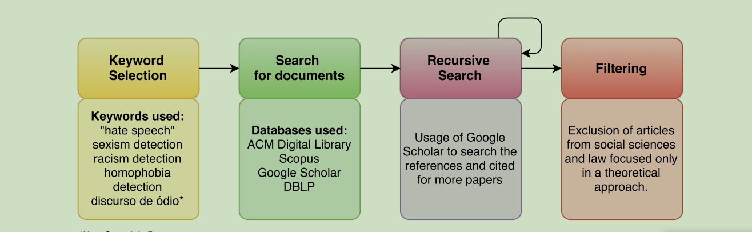
.
Hate speech is language that attacks or diminishes, that incites violence or hate against groups, based on specific characteristics such as physical appearance, religion, descent, national or ethnic origin, sexual orientation, gender identity or other, and it can occur with different linguistic styles, even in subtle forms or when humour is used.
Link: https://dev.to/nicfoxds/how-to-analyse-clean-text-data-in-python-2hb9

Slide 5
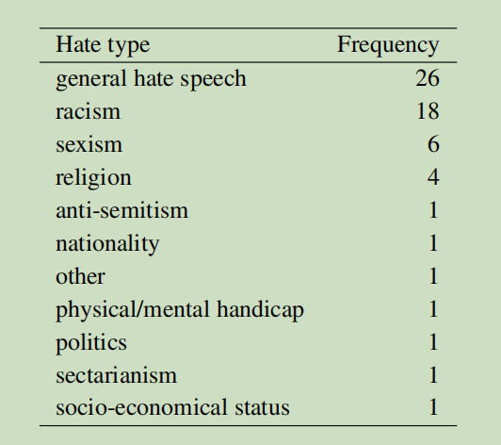
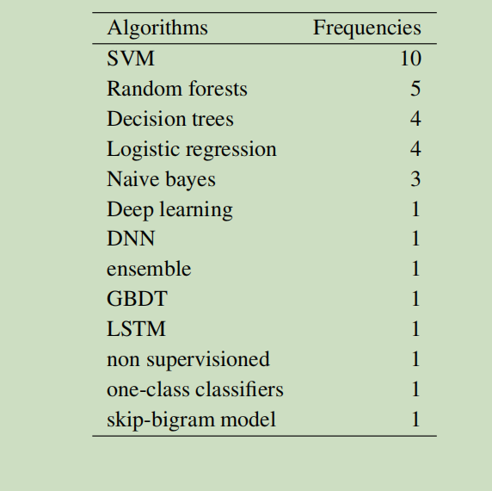
Type of hate speech analysed in the papers overall
Frequency of Algorithms used in the papers overall

Slide 6
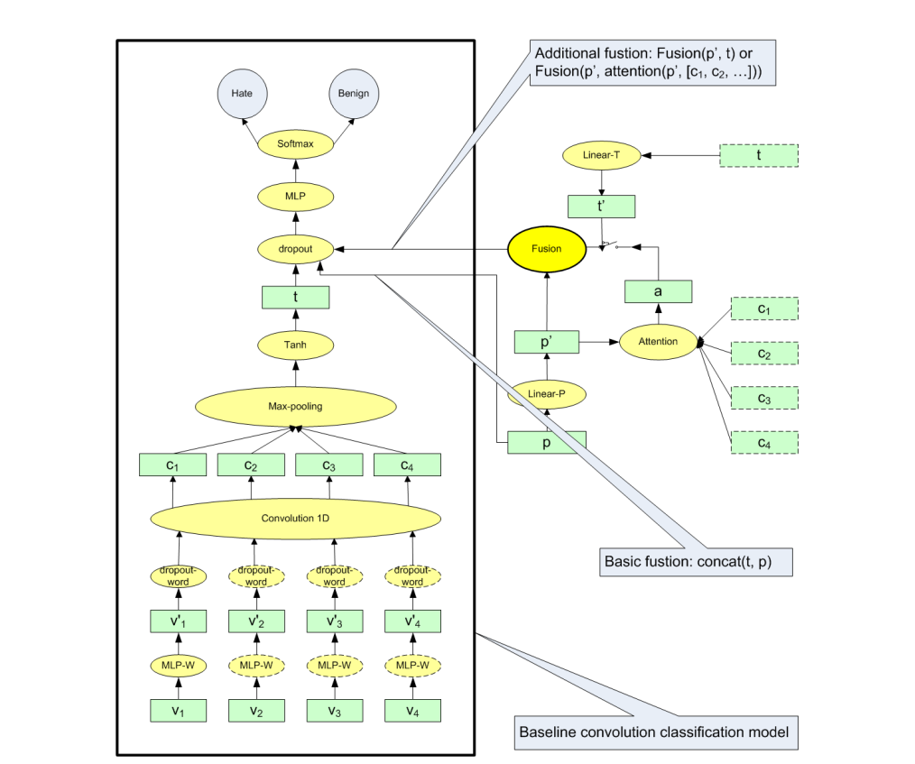
Exploring Deep Multimodal Fusion of Text and Photo for Hate Speech Classification
Proceedings of the Third Workshop on Abusive Language Online , 2019
MLP-W : Serves as solution for fine-tuning word embeddings to hate speech domain.
Gated Summation

Slide 7
Task 2 : Reasoning Of Meme Labelled Into Different Categories

Slide 8
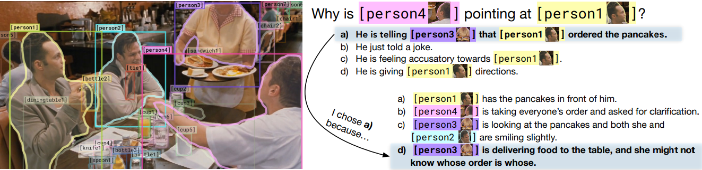
From Recognition to Cognition: Visual Commonsense Reasoning
https://arxiv.org/pdf/1811.10830.pdf
Dataset : Visual Commonsense Reasoning
Collected from Large Scale Movie Description Challenge and YouTube movie clips
List of objects
A query
A set of N responses

Slide 9
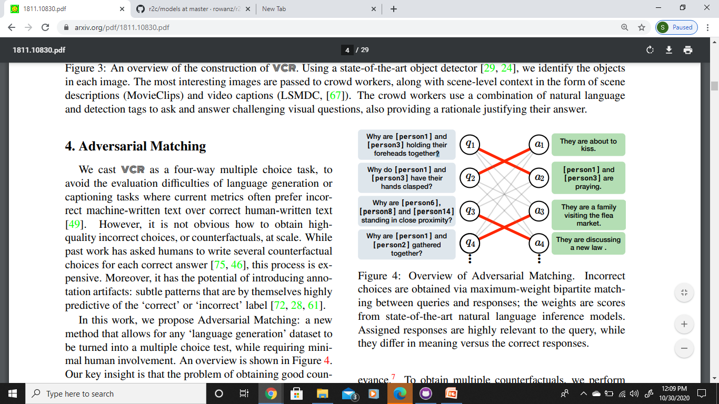
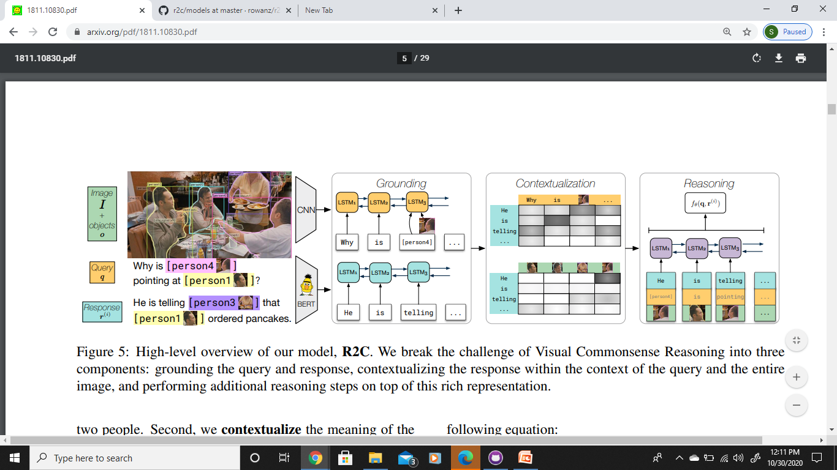
Adversarial Matching
For Question Answering Q -> A
Language generation dataset to Multiple Choice Test
Two subtasks:
- Answer is as relevant as possible
- Dissimilarity between other answers are from the correct answer
Maximum weight bipartite matching
Recognition to Cognition Model
QA -> R
Grounding
Contextualization
Reasoning

Slide 10
Leveraging Visual Question Answering for Image-Caption Ranking
Xiao Lin Devi Parikh
Bradley Department of Electrical and Computer Engineering,
Virginia Tech
{linxiao,parikh}@vt.edu

Slide 11
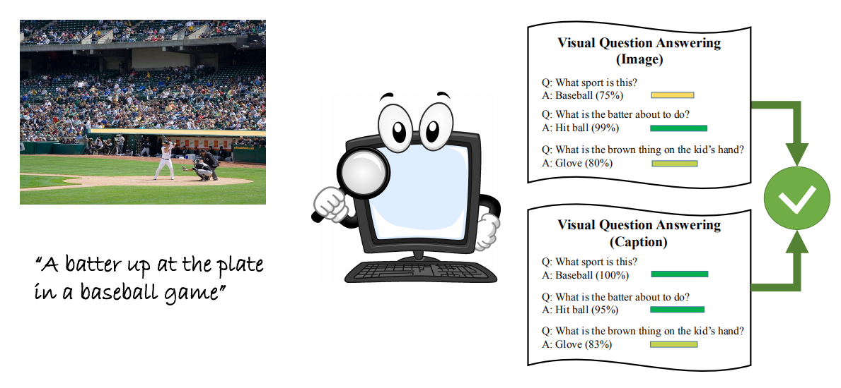

Slide 12
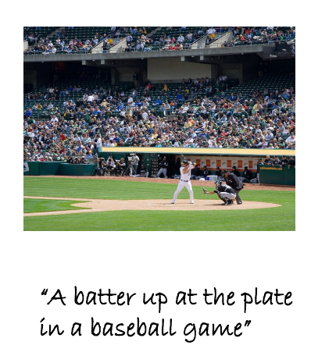
Using VQA knowledge to improve image-caption ranking.
Ex:Realizing that a batter up at the plate would imply that a player is
holding a bat
posing to hit the baseball
there might be another player nearby waiting to catch the ball

Slide 13
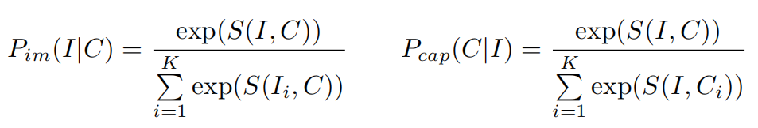
Image caption ranking
The image-caption ranking task is to retrieve relevant images given a query caption and relevant captions given a query image.
During training we are given image-caption pairs (I, C)
For each pair we sample K - 1 other images in addition to I so the image retrieval task becomes retrieving I from K images given caption C.
We also sample K-1 random captions in addition to C so the caption retrieval task becomes retrieving C from K given image I.
The image-caption ranking models learn a ranking scoring function S(I, C) such that the corresponding retrieval probabilities are maximised:

Slide 14
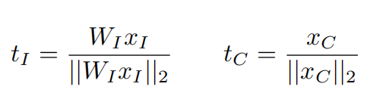
Baseline model
Model projects
D_{xI} - dimensional CNN activation xI for image I
D_{xC}- dimensional RNN latent encoding xC for caption C
to the same D_{xC}-dimensional common multi-modal embedding space as unit-norm vectors t_{I} and t_{C} :
The multi-modal scoring function is defined as their dot product St(I, C) =<t_{I} , t_{C} >.

Slide 15
VQA
VQA is the task of given an image I and a free-form open-ended question Q about I, generating a natural language answer A to that question.
Similarly,VQA-Caption task takes a caption C of an image and a question Q about the image, then generates an answer A.
The generated answers are evaluated using
min( (# humans that provided A/3) , 1).
That is, A is 100% correct if at least 3 humans (out of 10) provide the answer A.

Slide 16
During training, given triplets of question Q ,ground truth answer A
Image I,
We optimize the negative log-likelihood (NLL) loss to maximize the probability of the ground truth answer PI (A|Q, I) given by the VQA model.
Caption C,
We optimize the NLL loss to maximize the VQA-Caption model probability PC (A|Q, C).

Slide 17
For a VQA question (I, Q)
Image Encoding
Using the 19-layer VGGNet [46] as a 4,096-dimensional image encoding x_{I}
Qestion Encoding
Using a 2-layer RNN with 512 Long Short-Term Memory (LSTM) units per layer as a 2,048-dimensional question encoding x_{Q}.
Then x_{I} and x_{Q} are projected into a common 1,024-dimensional multi-modal space as z_{I} and z_{Q}
We then compute the representation z_{I+Q} for the image-question pair (I, Q) by element-wise multiplying z_{I} and z_{Q}
The scores s_{A} for 1,000 answers are given by: s_{A} = W_{s}z_{I+Q} + b_{s}

Slide 18
For the VQA-Caption task given caption C and question Q,
We use the same network architecture and learning procedure as above
But using the most frequent 1,000 words in training captions as the dictionary to construct a 1,000 dimensional bag-of-words encoding for caption C as x_{C} to replace the image feature x_{I} and compute z_{C} , z_{C+Q} respectively.
The VQA and VQA-Caption models are learned on the train split of the VQA dataset using
82,783 images, 413,915 captions and 248,349 questions.
These models achieve VQA validation set accuracies of
54.42% (VQA) and 56.28%(VQA-Caption).
Next, they are used as sub-modules in the image caption ranking approach.

Slide 19
Approach
To leverage knowledge in VQA for image-caption ranking we propose
to represent the images and the captions in the VQA space using VQA and VQA-Caption models.
This representations is called VQA-grounded representations.

Slide 20
Let’s say we have a
VQA model PI (A|Q, I), a VQA-Caption model PC (A|Q, C)
Set of N questions Qi
And their plausible answers (one for each question) Ai, i = 1, 2, ...N.
Then given an image I and a caption C, we first extract the N dimensional VQA-grounded activation vectors u_{I} for I and u_{C} for C
Such that each dimension i of u_{I} and u_{C} is the log probability of the ground truth answer Ai given a question Qi.

Slide 21
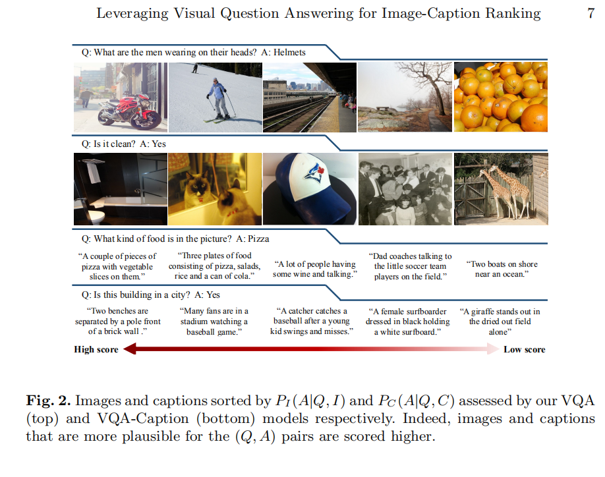
For example if the (Qi, Ai) pairs are
(Q1: What is the person riding?, A1:Motorcycle)
(Q2: What is the man wearing on his head?, A2: Helmet),
u(1)I and u(1)C verify if the person in image I and caption C respectively is riding a motorcycle.
At the same time u(2)I and u(2)C
verify whether the man in I and C
is wearing a helmet.

Slide 22
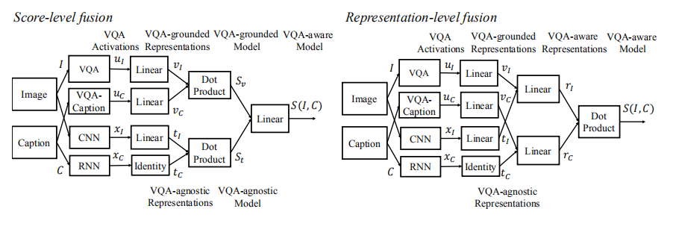
https://arxiv.org/pdf/1605.01379.pdf

